Slide 1
Office Computer Application WEEK TEN
Muhammad Unggul Pamenang

Slide 2
Please Do It With MS Excel from 2010 - 2016

Slide 3
Understanding Number Formats
5
MS Excel 2016

Slide 4
What are number formats?
Whenever you're working with a spreadsheet, it's a good idea to use appropriate number formats for your data. Number formats tell your spreadsheet exactly what type of data you're using, like percentages (%), currency ($), times, dates, and so on.

Slide 5
Why use number formats?
Number formats don't just make your spreadsheet easier to read—they also make it easier to use. When you apply a number format, you're telling your spreadsheet exactly what types of values are stored in a cell. For example, the date format tells the spreadsheet that you're entering specific calendar dates. This allows the spreadsheet to better understand your data, which can help ensure that your data remains consistent and that your formulas are calculated correctly.

Slide 6
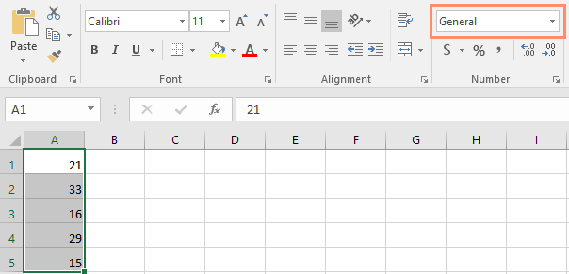
Applying number formats
Just like other types of formatting, such as changing the font color, you'll apply number formats by selecting cells and choosing the desired formatting option. There are two main ways to choose a number format:
Go to the Home tab, click the Number Format drop-down menu in the Number group, and select the desired format.

Slide 7
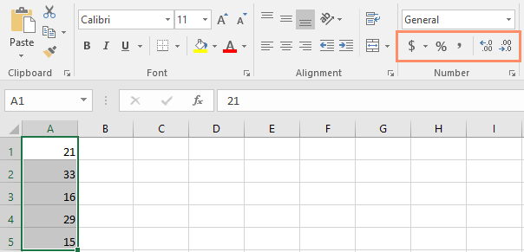
Applying number formats
You can also click one of the quick number-formatting commands below the drop-down menu.

Slide 8
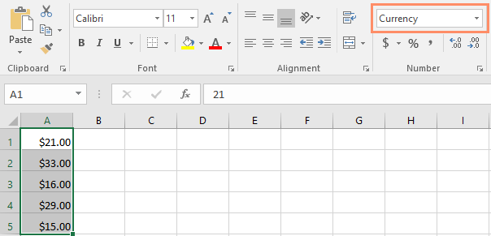
Applying number formats
In this example, we've applied the Currency number format, which adds currency symbols ($) and displays two decimal places for any numerical values.

Slide 9
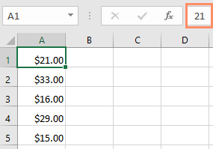
Applying number formats
If you select any cells with number formatting, you can see the actual value of the cell in the formula bar. The spreadsheet will use this value for formulas and other calculations.

Slide 10
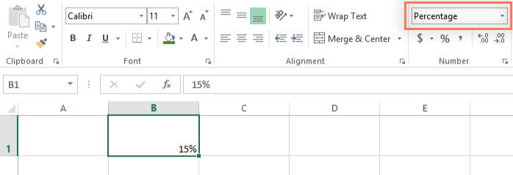
Percentage formats
One of the most helpful number formats is the percentage (%) format. It displays values as percentages, such as 20% or 55%. This is especially helpful when calculating things like the cost of sales tax or a tip. When you type a percent sign (%) after a number, the percentage number format will be be applied to that cell automatically.

Slide 11
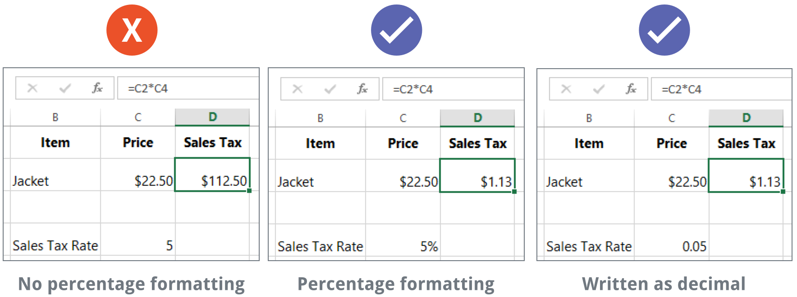
Percentage formats
There are many times when percentage formatting will be useful. For example, in the images below, notice how the sales tax rate is formatted differently for each spreadsheet (5, 5%, and 0.05):
As you can see, the calculation in the spreadsheet on the left didn't work correctly. Without the percentage number format, our spreadsheet thinks we want to multiply $22.50 by 5, not 5%. And while the spreadsheet on the right still works without percentage formatting, the spreadsheet in the middle is easier to read.

Slide 12
Date formats
Whenever you're working with dates, you'll want to use a date format to tell the spreadsheet that you're referring to specific calendar dates, such as July 15, 2014. Date formats also allow you to work with a powerful set of date functions that use time and date information to calculate an answer.
Spreadsheets don't understand information the same way a person would. For instance, if you type October into a cell, the spreadsheet won't know you're entering a date so it will treat it like any other text. Instead, when you enter a date, you'll need to use a specific format your spreadsheet understands, such as month/day/year (or day/month/year depending on which country you're in). In the example below, we'll type 10/12/2014 for October 12, 2014. Our spreadsheet will then automatically apply the date number format for the cell.

Slide 13
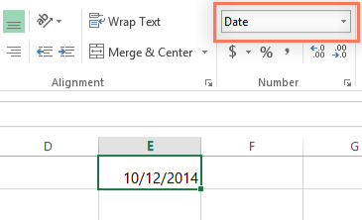
Date formats
Now that we have our date correctly formatted, we can do many different things with this data. For example, we could use the fill handle to continue the dates through the column, so a different day appears in each cell:

Slide 14
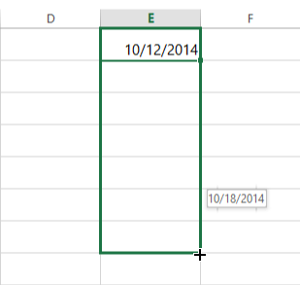
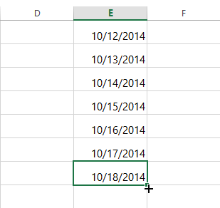
Date formats
If the date formatting isn't applied automatically, it means the spreadsheet did not understand the data you entered. In the example below, we've typed March 15th. The spreadsheet did not understand that we were referring to a date, so this cell is still using the general number format.

Slide 15
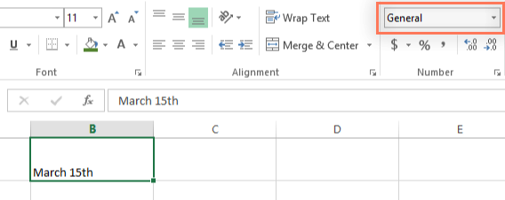
Date formats
On the other hand, if we type March 15 (without the "th"), the spreadsheet will recognize it as a date. Because it doesn't include a year, the spreadsheet will automatically add the current year so the date will have all of the necessary information. We could also type the date several other ways, such as 3/15, 3/15/2014, or March 15 2014, and the spreadsheet would still recognize it as a date.

Slide 16
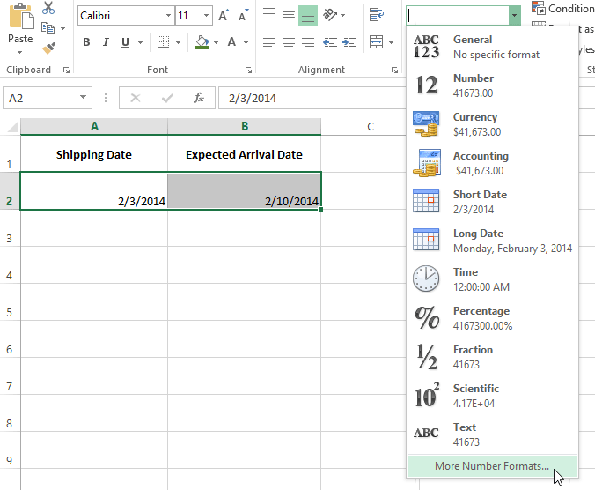
Other date formatting options
To access other date formatting options, select the Number Format drop-down menu and choose More Number Formats. These are options to display the date differently, like including the day of the week or omitting the year.

Slide 17
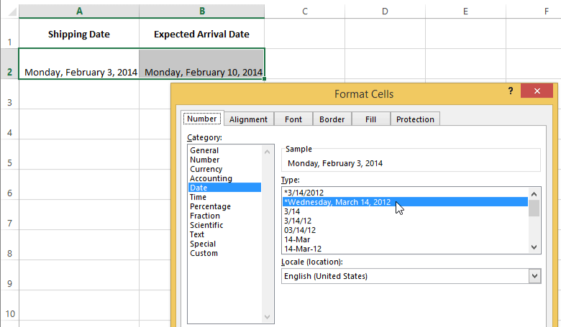
Other date formatting options
The Format Cells dialog box will appear. From here, you can choose the desired date formatting option.

Slide 18
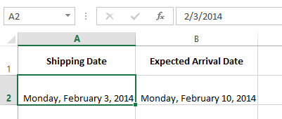
Other date formatting options
As you can see in the formula bar, a custom date format doesn't change the actual date in our cell—it just changes the way it's displayed.

Slide 19
Number formatting tips
Here are a few tips for getting the best results with number formatting:
Apply number formatting to an entire column: If you're planning to use one column for a certain type of data, like dates or percentages, you may find it easiest to select the entire column by clicking the column letter and applying the desired number formatting. This way, any data you add to this column in the future will already have the correct number format. Note that the header row usually won't be affected by number formatting.

Slide 20
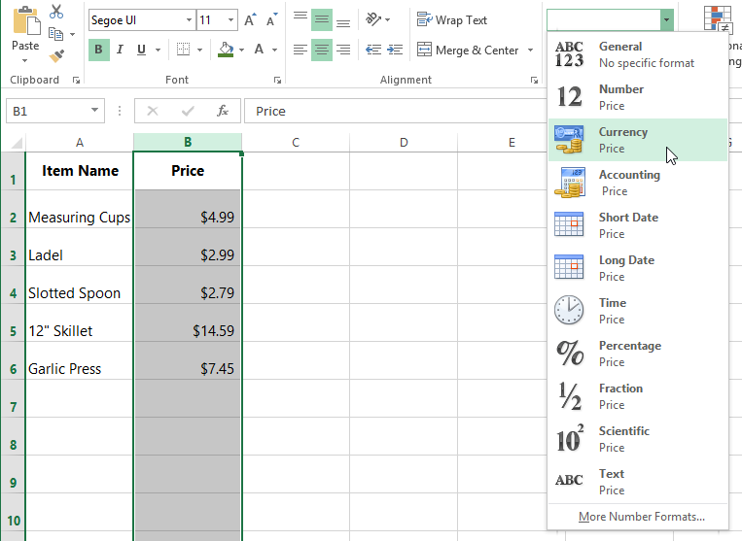
Number formatting tips

Slide 21
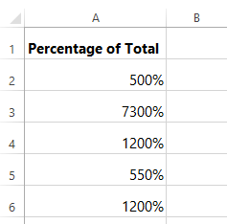
Number formatting tips
Double-check your values after applying number formatting: If you apply number formatting to existing data, you may have unexpected results. For example, applying percentage (%) formatting to a cell with a value of 5 will give you 500%, not 5%. In this case, you'd need to retype the values correctly in each cell.

Slide 22
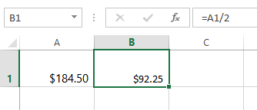
Number formatting tips
If you reference a cell with number formatting in a formula, the spreadsheet may automatically apply the same number formatting to the new cell. For example, if you use a value with currency formatting in a formula, the calculated value will also use the currency number format.

Slide 23
Number formatting tips
If you want your data to appear exactly as entered, you'll need to use the text number format. This format is especially good for numbers you don't want to perform calculations with, such as phone numbers, zip codes, or numbers that begin with 0, like 02415. For best results, you may want to apply the text number format before entering data into these cells.

Slide 24
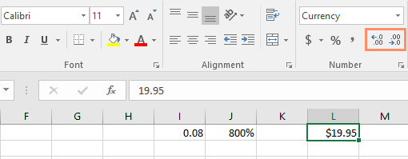
Increase and Decrease Decimal
The Increase Decimal and Decrease Decimal commands allow you to control how many decimal places are displayed in a cell. These commands don't change the value of the cell; instead, they display the value to a set number of decimal places.

Slide 25
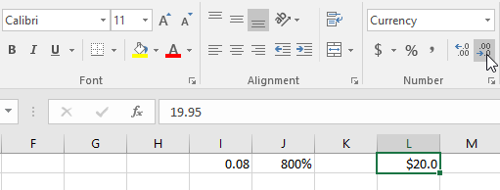
Increase and Decrease Decimal
Decreasing the decimal will display the value rounded to that decimal place, but the actual value in the cell will still be displayed in the formula bar.

Slide 26
JOBSHEET
Continue working

Slide 27
THANKS!

